Slide 1
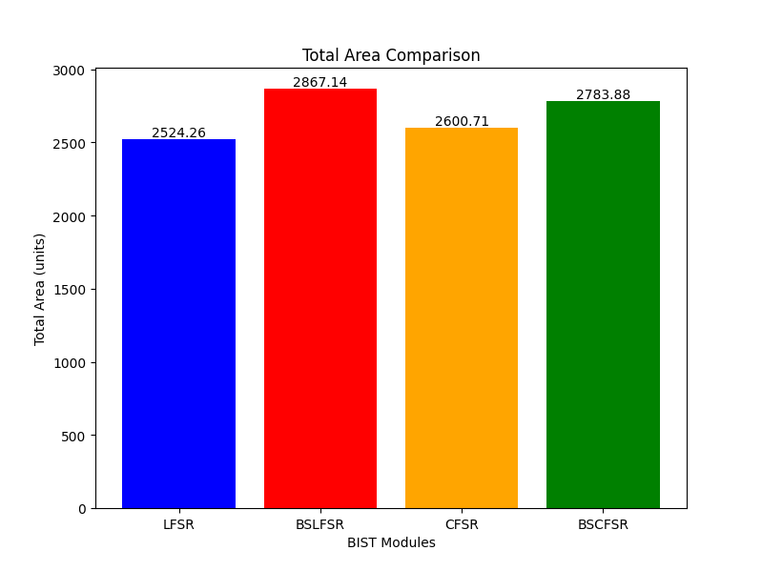
Clock Frequency=200MHZ Golden signature values in Code

Slide 2
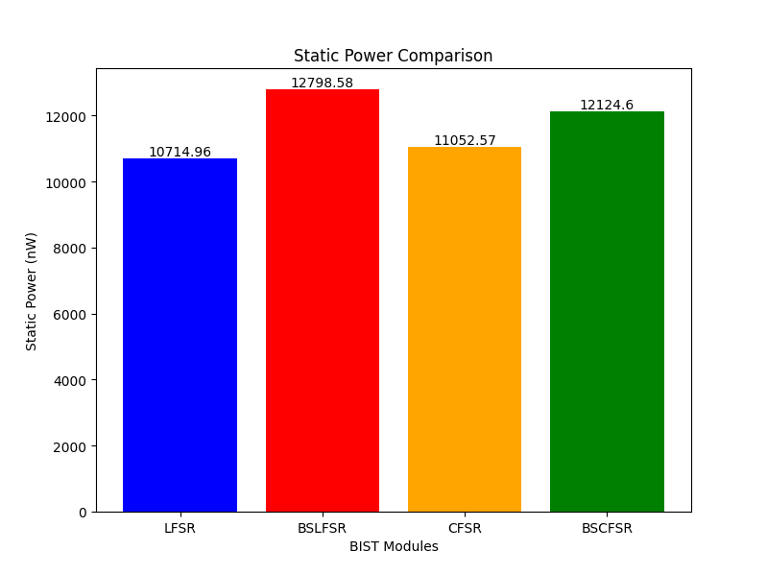
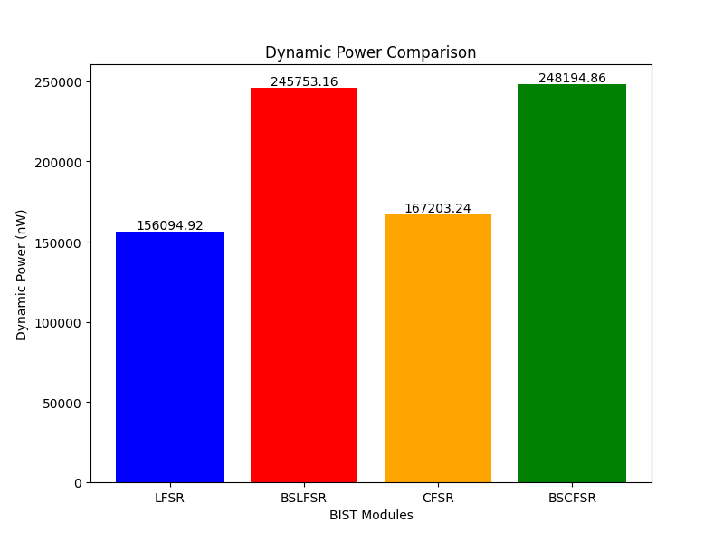

Slide 3

The Doubt is although we have reduced the transitions
In BSLFSR and BSCFSR The power is not been reduced instead these Bit swapping Pattern generators Consume more delay and Power.

Slide 4
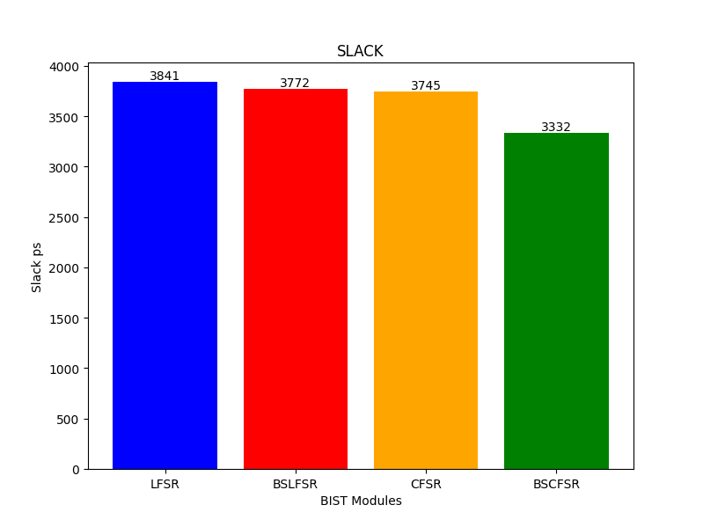

Slide 5
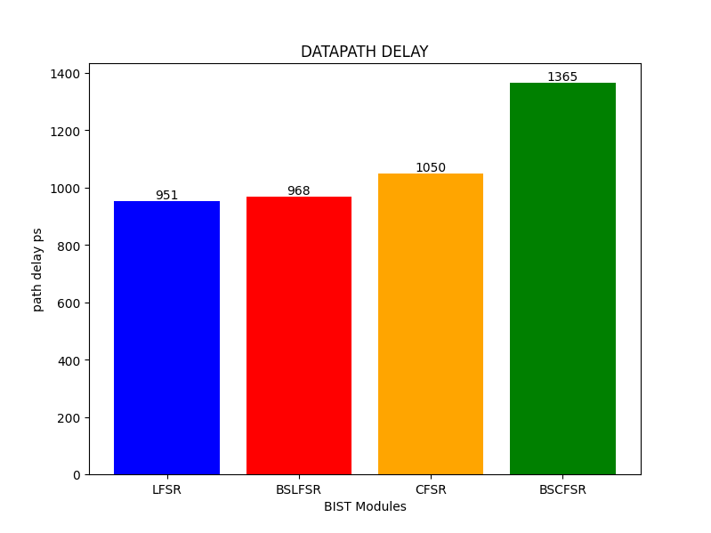

Slide 6
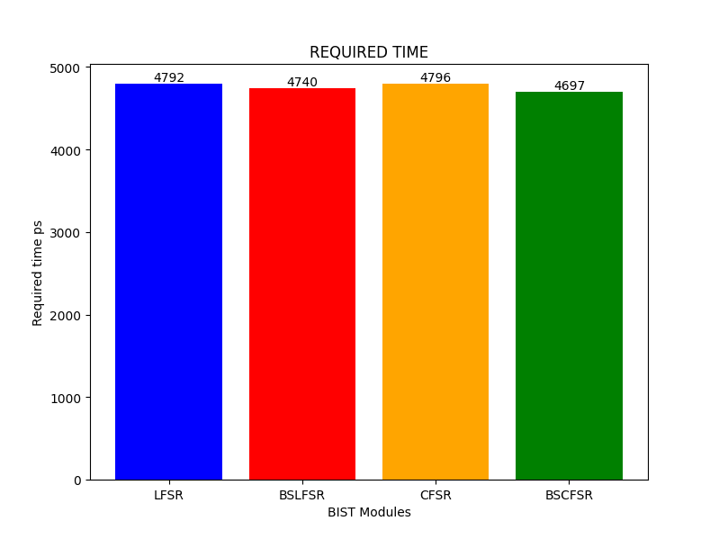

Slide 7
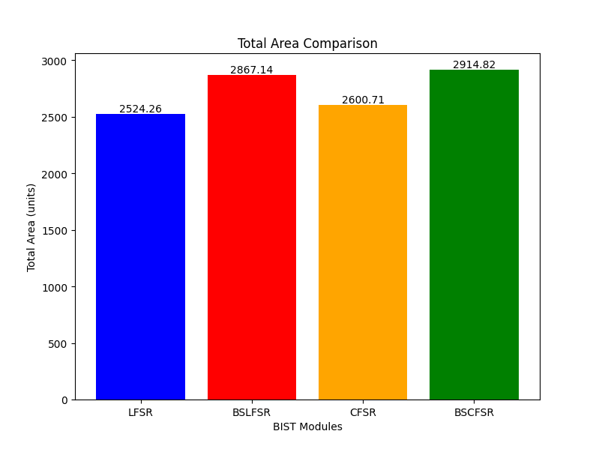
Clock Frequency=100MHZ Golden signature in stored in File
Here We have stored the golden signature values in the file and then reading it in the code

Slide 8

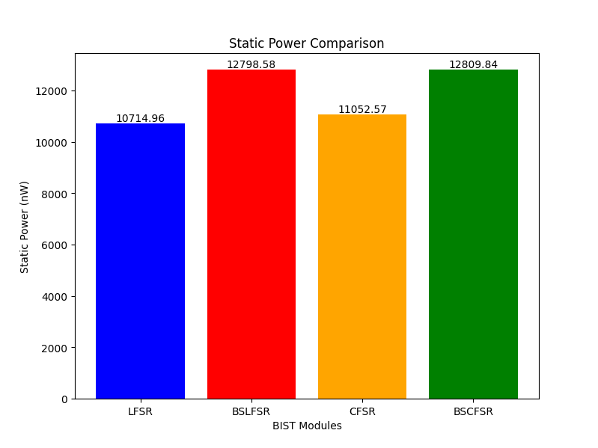

Slide 9

The Power Consumption is Reduced (Nearly it is half of the previous Method) if we use this Method. But we thought that We can’t Use file reading while dumping in the FPGA.

Slide 10
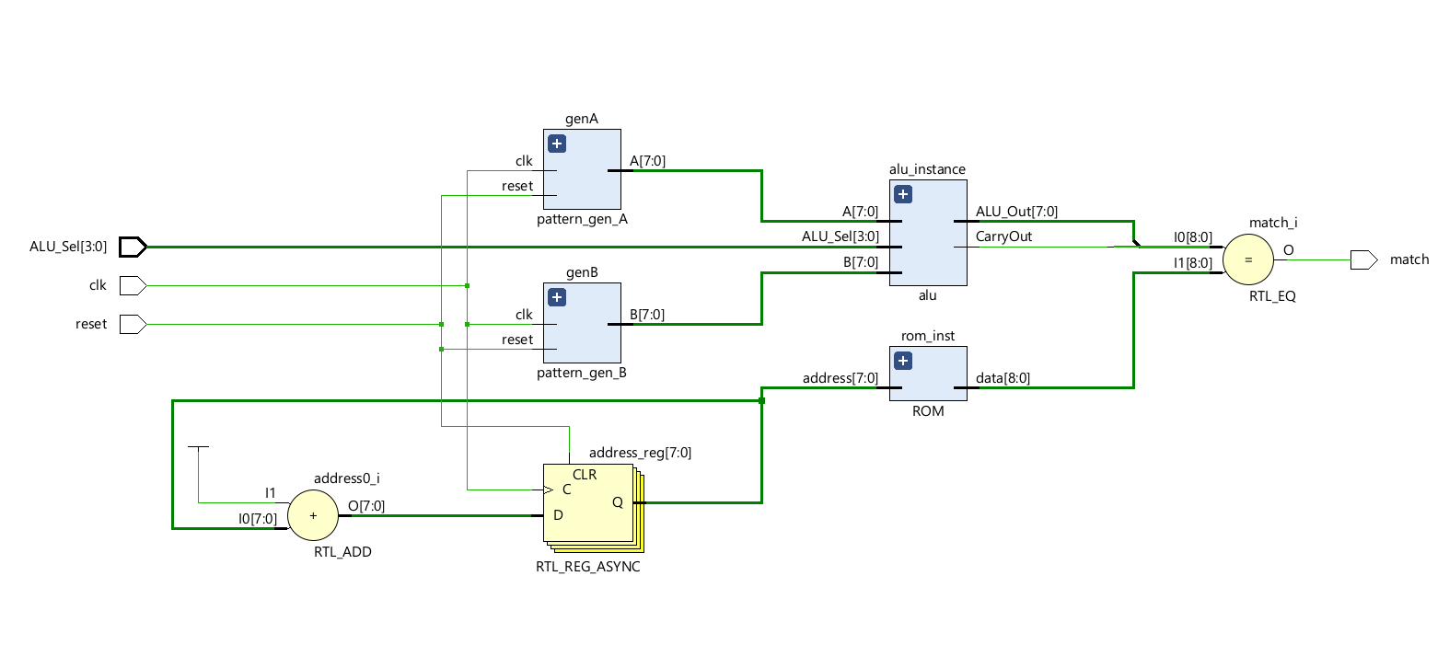
This is Overall BIST Architecture Schematic In VIVADO

Slide 11
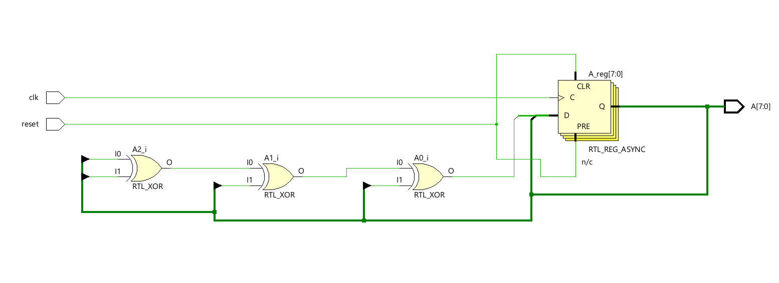
8 bit LFSR

Slide 12
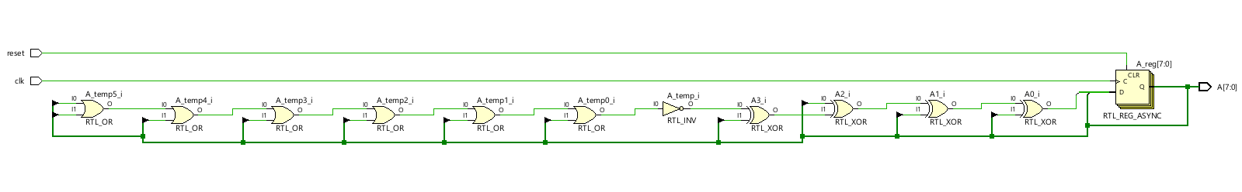
8 bit CFSR

Slide 13
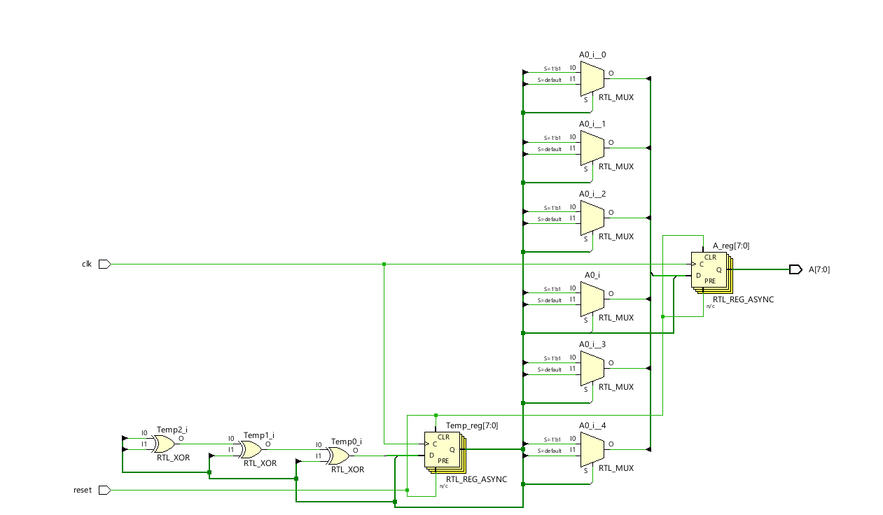
BSLFSR As shown in the papers We have used 6 Muxes to swap the bits

Slide 14
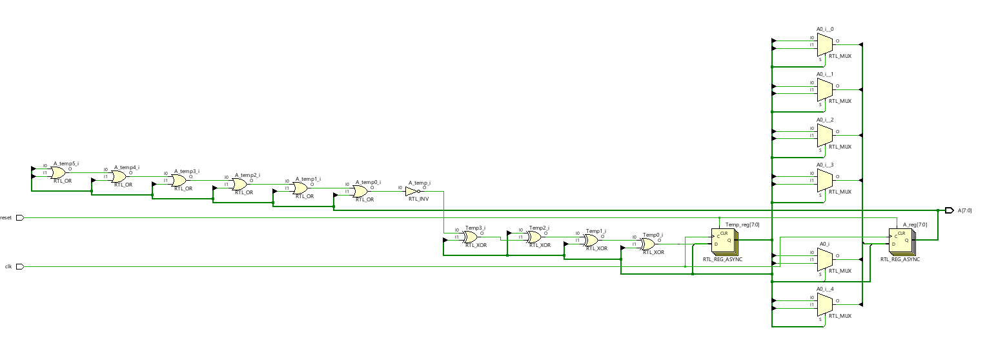
BSCFSR

Slide 15
The Swapping Can be done in Two ways 1) A[0] <= (Temp[7]) ? Temp[0] : Temp[1];
A[1] <= (Temp[7]) ? Temp[1] : Temp[0];
A[2] <= (Temp[7]) ? Temp[2] : Temp[3];
A[3] <= (Temp[7]) ? Temp[3] : Temp[2];
A[4] <= (Temp[7]) ? Temp[4] : Temp[5];
A[5] <= (Temp[7]) ? Temp[5] : Temp[4];
A[6] <= Temp[6];
A[7] <= Temp[7];
2) A <= (Temp[7]) ? (Temp) :({Temp[7],Temp[6],Temp[4],Temp[5],Temp[2],Temp[3],Temp[0],Temp[1]});
Condition if Select line=0 =>Swap
Here we are using 6 Mux (through ternary operators) as given in the architecture
Temp[1]
0
A[0]
Temp[0]
1
Temp[7]
(swapped)Temp[7:0]
0
A[7:0]
Temp[7:0]
1
Temp[7]
Which Method we should use ?? 2nd Method uses less area and less Power consumption then the first one.
Here the swapping is done through 1 Mux But the inputs and
Outputs to the Mux are in Vector form.

Slide 16
Overall Doubts 1) NO Problem with LFSR AND CFSR.
2)Although it is said that Bit swapping PRPG’s are used for low power consumption but In our Case we are not getting Low Power and Delays are also more.
3) Which Bit swapping Method should be used? 4) Should we give the Golden values in the code itself or read them from a file?

